Slide 1
Consumer Analytics Division 26/11/2015
Croma Store Analysis
POC - Hyderabad
The information contained in the document is proprietary to Tata Industries Limited- Consumer Analytics Division and is strictly confidential. In consideration of receipt of this document, the recipient agrees that the information is being shared only for the limited purpose. The recipient of this information further agrees to maintain such information in confidence and to not reproduce, disclose, duplicate, electronically transmit or use in whole or in part for any other purpose. Prior written consent shall be obtained from the Consumer Analytics Division of Tata Industries in case the information is necessitated to be shared with anyone other than the Recipient to whom this information is addressed. The above restriction shall not limit the right to use the information contained in this deck, if it is obtained from another source without restriction.
© Copyright, Consumer Analytics Division, Tata Industries Limited

Slide 2
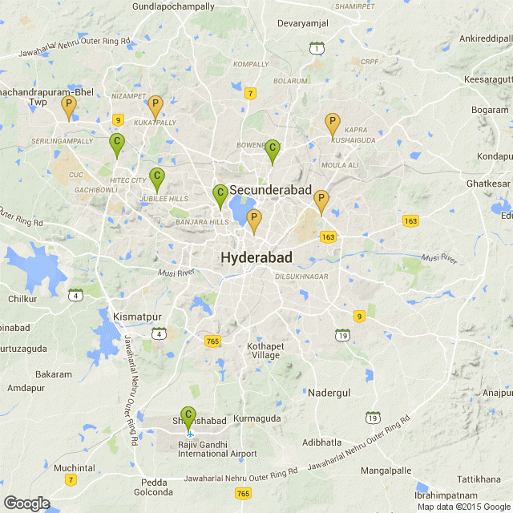
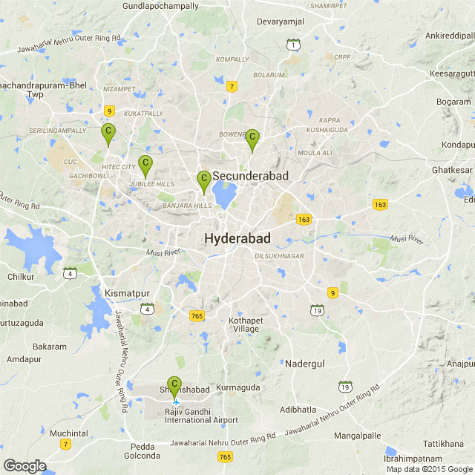
Background
Current State
Croma has 5 store locations in Hyderabad
  Jubilee Hills
  Panjagutta
  Vikrampuri
  Kondapur
  Rajiv Gandhi International Airport, Shamshabad
Additional Plan
Croma is exploring additional locations in Hyderabad:
  AS Rao Nagar
  Kukatpally
  Himayat Nagar
  Habsiguda
  Chandanagar
Objective
Validate the proposed store locations
Identify optimal store locations for Croma in Hyderabad

Slide 3





Optimal Store Location Model - Approach
Store Location Attractiveness is determined by Store Attractiveness and Area Potential and also the Distance to the store. Catchment Area Analysis on current stores helps us determine the exponents for each parameter
Probability of Store Visit from Catchment
Store/Competitor Attractiveness
Derived from Store Characteristics
Store/Competitor Distance
Driving Distance to Store/Competitor PIN
Store Location
Attractiveness
at PIN Level
Catchment
Area:
35 mins of drive
time
Potential of Catchment – for Croma Sales
Aggregated data Sources from CIBIL, Census and others
Aggregated TATA Indicash ATM data
TOP 50 PIN locations for CROMA
API
Driving Distance between PINs
Customer location - Gurgaon/Delhi stores Transaction data
Considered for analysis
ATM data

Slide 4
Model Application
Hyderabad
Indicative PINCODE map
Not to scale
Geo-location of current and planned Croma Stores is critical in determining the location attractiveness of a potential location
Doolapally
Kompally
Hakimpet
Alwal
Generals Road
Sainikpuri
Chandanagar
Kukatpally
Vikrampuri
Madinaguda
KpHB Colony
HAL
Anantram
A S Rao Nagar
CUC
Bowenpally
Nallagandla
Kothaguda
Panjagutta
Odyssey, Vikrampuri
Nehru Nagar
Malkajgiri
Gachibowli
Kondapur
Panjagutta
M G Road
Mallapur
Jawahar Nagar
Sitaphalmandi
Nacharam
Madniguda
HiTec City
Begumpet
Amsri Faust,
Secunderabad
Railway Workshop
Secretariat
Bhoiguda Road
Jubilee Hills
Banjara Hills
Khairatabad
Manikonda
Hill Fort Road
Chikkadpally
Nallakunta
Golconda
Lakdi-ka-Pul
HImayatnagar
Shivam Road
Habsiguda
Osman Nagar
Tolichowki
Kachiguda
Uppal
Abids
Koti
Army Golf Course
Karwan
Malakpet
Dilkushnagar
Attapur
High Court
CharMinar
Kothapete
Bandlaguda
Nehru Zoological Park
Malkapet
Kothapete
Alkapuri
Himayathsagar
Padmasri Estates
Murad Nagar
Kismatpur
Sivarampalli
Falaknuma
Saidabad
Saroornagar
LB Nagar
Gagan Pahad
Kamaguda
Hastinapuram
Vanasthalipuram
Airport
Existing
Croma Store Locations
Proposed Croma Store Locations

Slide 5
Model Application – Competitor Presence
Hyderabad
Indicative PINCODE map
Not to scale
Kompally
Geo-location of existing and planned Croma Stores is critical in determining the location attractiveness of a potential location
Doolapally
Hakimpet
Alwal
Generals Road
Sainikpuri
Chandanagar
Kukatpally
Vikrampuri
Madinaguda
KpHB Colony
HAL
Anantram
A S Rao Nagar
CUC
Bowenpally
Nallagandla
Kothaguda
Panjagutta
Odyssey, Vikrampuri
Nehru Nagar
Malkajgiri
Gachibowli
Kondapur
Panjagutta
M G Road
Mallapur
Distance from competitor stores and Croma stores determines the probability of store visit from Catchment
Jawahar Nagar
Sitaphalmandi
Nacharam
Madniguda
HiTec City
Begumpet
Amsri Faust,
Secunderabad
Railway Workshop
Secretariat
Bhoiguda Road
Jubilee Hills
Banjara Hills
Khairatabad
Manikonda
Hill Fort Road
Chikkadpally
Nallakunta
Golconda
Lakdi-ka-Pul
HImayatnagar
Shivam Road
Habsiguda
Osman Nagar
Tolichowki
Kachiguda
Uppal
Abids
Koti
Army Golf Course
Karwan
Malakpet
Dilkushnagar
Attapur
High Court
CharMinar
Kothapete
Bandlaguda
Nehru Zoological Park
Malkapet
Kothapete
Alkapuri
Himayathsagar
Padmasri Estates
Murad Nagar
Kismatpur
Sivarampalli
Falaknuma
Saidabad
Saroornagar
LB Nagar
Hastinapuram
Gagan Pahad
Kamaguda
Vanasthalipuram
Airport
Existing
Croma Store Locations
Proposed Croma Store Locations
Reliance Digital Stores
Bajaj Electronics Stores

Slide 6
Model Application – Croma Sales Potential
Hyderabad
Indicative PINCODE map
Not to scale
Kompally
Geo-location of existing and planned Croma Stores is critical in determining the location attractiveness of a potential location
Doolapally
Hakimpet
Alwal
Generals Road
Sainikpuri
Chandanagar
Kukatpally
Vikrampuri
Madinaguda
KpHB Colony
HAL
Anantram
A S Rao Nagar
CUC
Bowenpally
Nallagandla
Kothaguda
Panjagutta
Odyssey, Vikrampuri
Nehru Nagar
Malkajgiri
Gachibowli
Kondapur
Panjagutta
M G Road
Mallapur
Distance from competitor stores and Croma stores determines the probability of store visit from Catchment
Jawahar Nagar
Sitaphalmandi
Nacharam
Madniguda
HiTec City
Begumpet
Amsri Faust,
Secunderabad
Railway Workshop
Secretariat
Bhoiguda Road
Jubilee Hills
Banjara Hills
Khairatabad
Manikonda
Hill Fort Road
Chikkadpally
Nallakunta
Golconda
Lakdi-ka-Pul
HImayatnagar
Shivam Road
Habsiguda
Osman Nagar
Tolichowki
Kachiguda
Uppal
Abids
Koti
Potential of the Catchment area for Croma sales is the other driver for location attractiveness
Army Golf Course
Karwan
Malakpet
Dilkushnagar
Attapur
High Court
CharMinar
Kothapete
Bandlaguda
Nehru Zoological Park
Malkapet
Kothapete
Alkapuri
Himayathsagar
Padmasri Estates
Murad Nagar
Kismatpur
Sivarampalli
Falaknuma
Saidabad
Saroornagar
LB Nagar
Kamaguda
Hastinapuram
Gagan Pahad
Vanasthalipuram
Airport
Existing
Croma Store Locations
Proposed Croma Store Locations
Reliance Digital Stores
Bajaj Electronics Stores
Croma sales PIN Potential gradient –
High to Low

Slide 7
Model Application – Croma Sales Potential
Hyderabad
Indicative PINCODE map
Not to scale
Kompally
Croma does not have a presence in sections of Secunderabad which has relatively lesser competition – should Croma establish a presence in this region?
Doolapally
Hakimpet
Alwal
Generals Road
Sainikpuri
Chandanagar
Kukatpally
Vikrampuri
Madinaguda
KpHB Colony
HAL
Anantram
A S Rao Nagar
CUC
Bowenpally
Nallagandla
Kothaguda
Panjagutta
Odyssey, Vikrampuri
Nehru Nagar
Malkajgiri
Gachibowli
Kondapur
Panjagutta
M G Road
Mallapur
The south east section of the city has dense competition presence and medium potential, should Croma consider this region?
Jawahar Nagar
Sitaphalmandi
Nacharam
Madniguda
HiTec City
Begumpet
Amsri Faust,
Secunderabad
Railway Workshop
Secretariat
Bhoiguda Road
Jubilee Hills
Banjara Hills
Khairatabad
Manikonda
Hill Fort Road
Chikkadpally
Nallakunta
Golconda
Lakdi-ka-Pul
HImayatnagar
Shivam Road
Habsiguda
Osman Nagar
Tolichowki
Kachiguda
Uppal
Abids
Koti
Army Golf Course
Karwan
Malakpet
Dilkushnagar
Attapur
High Court
CharMinar
Kothapete
Bandlaguda
Malkapet
Kothapete
Secretariat and Hill Fort Road are close to high potential locations with minimal competitor presence – should Croma consider these locations?
Padmasri Estates
Nehru Zoological Park
Alkapuri
Himayathsagar
Murad Nagar
Kismatpur
Sivarampalli
Falaknuma
Saidabad
Saroornagar
LB Nagar
Kamaguda
Hastinapuram
Gagan Pahad
Vanasthalipuram
Airport
Existing
Croma Store Locations
Proposed Croma Store Locations
Reliance Digital Stores
Bajaj Electronics Stores
Croma sales PIN Potential gradient –
High to Low

Slide 8


Model Results – Relative Location Attractiveness Scores
Overall, the proposed Croma locations appear to be more attractive locations compared to existing Croma store locations
Existing Stores
Proposed Stores
Store | Relative Location Attractiveness Score
Jubilee Hills | 24
Kondapur | 20
Vikrampuri | 16
Airport, Shamshabad | 15
Panjagutta | 13
Average | 17.9
Store | Relative Location Attractiveness Score
Himayat Nagar | 35
Habsiguda | 28
Kukatpally | 16
AS Rao Nagar | 13
Chandanagar | 8
Average | 20.0
Average across all stores
Average across all stores
21.5
22.6
The existing Croma store locations do not appear to be as attractive as the overall presence of the competition
Overall, the planned Croma store locations appear to be more attractive locations compared to existing Croma store locations
Among the proposed locations, Chandanagr stands out for a relatively low location attractiveness score
Best Location for Reliance Digital – Kachiguda: Score-36 (PIN 500027); Best Location for Bajaj Electronics – Lakdi-ka-Pul: Score-37 (PIN 500004)

Slide 9
Thank You
Appendix

Slide 10
Background
Croma has 5 stores in Hyderabad
Location | Address of Premises/Store
Jubilee Hills - Hyderabad | CROMA , Ground Flr & First , Plot no.755 , Road no.36 ,Jubille Hills ,Hyderabad -500033
Panjagutta - Hyderabad | CROMA,'Prestige Towers" Ground Flr6-3-664,Panjagutta Main Road, Somajiguda, Hyderabad - 500018
Vikrampuri Hyderabad | CROMA,Ground Floor,Gayatri Westend,Survey No.54,Kakaguda,Karkhana Road,Vikrampuri,Secunderabad-500015
Kondapur Hyderabad | CROMA , Ground. Floor of building Nagarjuna Ikon, at Plot # 4 part of 5 & 6, Sy. No. 19,Kothaguda, Serlingampally Mandal, Ranga Reddy District, Kondapoor, Hyderabad- 50008.
Hyderabad Airport Store | CROMA ,Unit no. SU 16a, Level F, Domestic departure, Rajiv Gandhi International Airport, Shamshabad, Hyderabad – 500409
Croma is exploring additional locations in Hyderabad to ensure reach throughout the city. Key Identified locations are:
A S Rao Nagar (Main Road)
Himayat Nagar (Main Road)
Habsiguda (Main Road)
Kukatpally (Main Road)
Chandanagar (Main Road)

Slide 11
The Business Problem
Competition
Modernity & affluence levels of key catchments in Hyderabad
Consumer demographics in various regions of Hyderabad
Knowledge from other Tata retail organizations
Heat maps for the new sites proposed
Additional hotspots Croma can consider for new stores
Key Decision Points
Expected Outcomes
Validation of 5 identified store locations
Identification of the 5 best pin locations

Slide 12
Optimal Store Location Model - Approach: Catchment Area
Store Location Attractiveness is determined by Store Attractiveness and Area Potential and also the Distance to the store. Catchment Area Analysis on current stores helps us determine the exponents for each parameter
Attractiveness is a function of:
Square Foot Area, Size and Layout
Number and quality of Sales People per sq. foot
Measure of stock out
Attractive Promotions
Parking Space availability
Not Considered
(Lack of Data)
Store/Competitor
Attractiveness
Distance is:
Distance from the pin along the driveway
Traffic Congestion/Drive Time to the Store location PIN (Source – Google API)
Considered
Store Location
Attractiveness
at PIN Level
Store/Competitor
Distance
Potential of the catchment area PINs is a function of:
Affluence levels
Population strength
Demographic estimates
Future economic growth of the area
Considered
Potential –
for Croma Sales

Slide 13
Defining Store Catchment Area – at PIN level
Catchment area of a store location PIN is defined to include all PINs that lie within a 35 minute driving distance from it
Catchment Area
Driving distance of catchment PIN from Store Location PIN
Driving time cut off – 35 minutes
Accounting for more than 85% of store sales on an average. (Source – Google API)
PIN for Store Location
Adjacent
PIN 2 …with competitor store
Adjacent
PIN 3
Adjacent
PIN 4
Adjacent
PIN 1
Adjacent
PIN ..n
Gurgaon and Delhi – 5 sample stores
Derived from Transaction data shared
Store | PIN | % Sales from PINs within 35 minutes Driving time
Gurgaon – Sector 29 | 122007 | 92%
Gurgaon – DLF Mega Mall | 122002 | 89%
Gurgaon – Trade Tower | 122018 | 94%
Delhi – Rajouri | 110027 | 71%
Delhi – Saket | 110017 | 89%

Slide 14

Studying Store Catchment Area
The distance to the location of the store and the potential of the catchment are can be quantified for every PIN in Hyderabad district
PIN Location based Catchment Area
Croma Sales Potential of PIN
PIN for Store Location
Adjacent
PIN 2 …with competitor store
Adjacent
PIN 3
Adjacent
PIN 4
Adjacent
PIN 1
Adjacent
PIN ..n
Aggregated PIN level data
Top 50 Croma PINs
PIN level Croma sales potential score
A
Probability of Store Visit from PIN
Driving distance to Store Location PIN
PIN level probability of Store Visit
B
Driving Distance to other store/competitor PINs
Store Location
Attractiveness
A
*
B
across PINs in catchment

Slide 15


Probability of Visit
Pin 2
Probability of a person from Pin 1 visiting any store in another pin is dependent upon:
Distance from the pin (d)
Number of stores in the visiting pin
As a result, the probability of a Person A visiting a store in Pin 3 (p2) might be higher than visiting a store in Pin 4 (p3) as there is lesser competition in Pin 3
p1
Pin 3
d1
p2
The Concept
Pin 1
d2
p3
Pin 4
Person A
d3
Framework
All PINs in Hyderabad District | Planned Croma Store | Planned Croma Store | . | Planned Croma Store | Croma Store 1 | . | Croma Store 5 | Competitor Store 1 | Competitor Store 2 | Competitor Store 3 | Remainder PINs |  | Remainder PINS | . | Remainder PINs .. N
Area/Store PINs | PIN P1 | PIN P2 | . | PIN P5 | PIN P6 | . | PIN P10 | PIN P10 | PIN P11 | PIN P11 | PIN P12 |  | PIN P13 | . | PIN Pn
PIN 1 | pp1 | pp2 | . | pp5 | pp6 | . | pp10 | pp10 | pp11 | pp11 | pp12 |  | pp13 | . | ppn
PIN 2
.
.
PIN n

Slide 16

Potential of PIN- Logistic Regression
The Top 50 Croma PINs were treated as targets to identify PIN characteristics that would identify a High Potential PIN for Croma
Top 50 Croma PINs
Universe of Aggregated Variables at PIN level
CROMA High
Potential PINs
(1)
Volume of Loans by Category
Volume, Average age and Credit Worthiness of Borrowers by Category
Volume of Credit Inquiries by Category
Recency and Size of trades by category
Credit Volume and Utilization by category
All Other PINs
Other PINs
(0)
Selection of significant Variables that define a Performing PIN vs. a Non-Performing PIN
Significant Variables
Population of Professionals Proxy | (+)
Average Age Proxy | (-)
Volume of two wheeler trades Proxy | (-)
Credit Card usage | (+)
Personal Loan adoption | (-)
Increase in Credit Card usage | (+)
Small Business Proxy | (-)
Co-Relation

Slide 17
Potential of PIN - Logistic Regression Results
The Score identifies relatively Affluent, populated and sophisticated PINs with a slightly younger demography
Affluence
Population
# Total PINs | 104
High* | 83
Med-Low* | 21
in lakhs
In thousands
* Score Classification based on National ranking
Sophistication
Average Age

Slide 18
Computing Model Results
Model Results are arrived at by combining probability of store visit with the potential of the catchment area of the store location
For each pair of PINs we have a probability score. For each PIN we have a potential score
Probability
Store Location Preference
Scores | High | Medium | Low | Zero
High
Medium
Low
Highest
Potential
Lowest
A total score for each PIN is calculated based on the number of High-High, High-Medium and Medium-High Combinations it has

Slide 19
Results
The Model results provide a relative rank ordering of store locations with respect to attractiveness as a Croma store location
 | New Store | New Store | New Store | New Store | New Store
 | AS Rao Nagar | Kukatpally | Himayat Nagar | Habsiguda | Chanda Nagar
PIN Potential-Visit Probability* | 500062 | 500072 | 500029 | 500007 | 500050
High-Zero | 55% | 47% | 38% | 38% | 65%
High-High | 13% | 11% | 10% | 15% | 6%
High-Medium | 5% | 8% | 17% | 13% | 2%
High-Low | 8% | 14% | 14% | 13% | 7%
Medium-Zero | 17% | 17% | 10% | 13% | 18%
Medium-High | 0% | 0% | 7% | 1% | 0%
Medium-Medium | 1% | 0% | 2% | 3% | 0%
Medium-Low | 0% | 1% | 0% | 2% | 0%
Low-Zero | 2% | 1% | 1% | 1% | 1%
Low-High | 0% | 0% | 1% | 0% | 0%
Low-Medium | 0% | 0% | 0% | 0% | 1%
Low-Low | 0% | 1% | 0% | 1% | 0%
Relative Location Attractiveness | 17% | 18% | 34% | 29% | 8%
TATA CROMA | TATA CROMA | TATA CROMA | TATA CROMA | TATA CROMA
Jubilee Hills | Somajiguda | Karkhana Road | Kondapur | Shamshabad
500033 | 500018 | 500015 | 500081 | 500409
43% | 58% | 48% | 52% | 69%
9% | 3% | 14% | 8% | 5%
14% | 11% | 5% | 12% | 3%
13% | 9% | 13% | 9% | 3%
16% | 18% | 16% | 17% | 10%
0% | 0% | 0% | 1% | 8%
1% | 0% | 1% | 0% | 1%
1% | 0% | 1% | 0% | 0%
0% | 1% | 1% | 0% | 1%
0% | 0% | 0% | 1% | 1%
1% | 1% | 0% | 0% | 0%
1% | 0% | 1% | 1% | 0%
23% | 13% | 19% | 20% | 15%
Model includes Competition stores in Hyderabad - Reliance Digital and Bajaj Electronics
* Score result combines the rank ordering of the catchment area potential with the rank ordering of the probability of store visit for each PIN in catchment
Note:
The existing Croma store locations do not appear to be as attractive as the overall presence of the competition
Overall, the planned Croma store locations appear to be more appropriate locations compared to existing Croma store locations

Slide 20
Current State
Hyderabad
Indicative PINCODE map
Not to scale
Kompally
Existing
Croma Store Locations
Doolapally
Hakimpet
Alwal
Generals Road
Sainikpuri
Chandanagar
Kukatpally
Vikrampuri
Proposed Croma Store Locations
Madinaguda
KpHB Colony
HAL
Anantram
A S Rao Nagar
CUC
Bowenpally
Nallagandla
Kothaguda
Panjagutta
Odyssey, Vikrampuri
Nehru Nagar
Malkajgiri
Gachibowli
Kondapur
Panjagutta
M G Road
Mallapur
Reliance Digital Stores
Jawahar Nagar
Sitaphalmandi
Nacharam
Madniguda
HiTec City
Begumpet
Amsri Faust,
Secunderabad
Railway Workshop
Secretariat
Bhoiguda Road
Jubilee Hills
Banjara Hills
Khairatabad
Bajaj Electronics Stores
Manikonda
Hill Fort Road
Chikkadpally
Nallakunta
Lakdi-ka-Pul
HImayatnagar
Shivam Road
Habsiguda
Osman Nagar
Kondapur
Tolichowki
Kachiguda
Uppal
Abids
Koti
Croma sales PIN Potential gradient –
High to Low
Army Golf Course
Karwan
Malakpet
Dilkushnagar
Attapur
High Court
CharMinar
Kothapete
Bandlaguda
Nehru Zoological Park
Malkapet
Kothapete
Alkapuri
Himayathsagar
Padmasri Estates
Murad Nagar
Kismatpur
Sivarampalli
Falaknuma
Saidabad
Saroornagar
LB Nagar
Gagan Pahad
Kamaguda
Hastinapuram
Vanasthalipuram
Airport

Slide 21
Potential Considerations
Hyderabad
Indicative PINCODE map
Not to scale
Kompally
Existing
Croma Store Locations
Doolapally
Hakimpet
Alwal
Generals Road
Sainikpuri
Chandanagar
Kukatpally
Vikrampuri
Potential Considerations - Croma Store Locations
Madinaguda
KpHB Colony
HAL
Anantram
A S Rao Nagar
CUC
Nallagandla
Kothaguda
Panjagutta
Bowenpally
Odyssey, Vikrampuri
Nehru Nagar
Malkajgiri
Gachibowli
Kondapur
Panjagutta
M G Road
Mallapur
Reliance Digital Stores
Jawahar Nagar
Sitaphalmandi
Nacharam
Madniguda
HiTec City
Begumpet
Amsri Faust,
Secunderabad
Railway Workshop
Secretariat
Bhoiguda Road
Jubilee Hills
Banjara Hills
Khairatabad
Bajaj Electronics Stores
Manikonda
Hill Fort Road
Chikkadpally
Nallakunta
Lakdi-ka-Pul
HImayatnagar
Shivam Road
Habsiguda
Osman Nagar
Kondapur
Tolichowki
Kachiguda
Uppal
Abids
Koti
Croma sales PIN Potential gradient –
High to Low
Army Golf Course
Karwan
Malakpet
Dilkushnagar
Attapur
High Court
CharMinar
Kothapete
Bandlaguda
Nehru Zoological Park
Malkapet
Kothapete
Alkapuri
Himayathsagar
Padmasri Estates
Murad Nagar
Kismatpur
Sivarampalli
Falaknuma
Saidabad
Saroornagar
LB Nagar
Gagan Pahad
Kamaguda
Hastinapuram
Vanasthalipuram
Airport

Slide 22

Analysis – Next Steps
By incorporating Store Attractiveness and data sources that would provide more granular aggregation (street/ward level) the final recommendation would be made more accurate and granular
Store Attractiveness
Square Foot Area, Size and Layout
Use TATA Communications ATM data
Transaction Volumes and Values by ATM location
Refine PIN level recommendations to location level recommendations
Granular Model Build
Ward/Street level granularity in recommendations
Model build at ward/street level, replacing PIN
Incorporate Points of Interest (POIs) like restaurants, railway stations and others
Number and quality of Sales People per sq. foot
Measure of stock out
Attractive Promotions
Parking Space availability
Granular Recommendations
ATM data

Slide 23
Store Analytics
Leveraging data sources that would build a comprehensive profile of the store location characteristics, we can rationalize Segmentation and Targeting, identify growth opportunities and benchmark store performance
Geo-Location
Segmentation and Targeting
Rationalize Segments catered to
Understand Competitor segments
Growth Opportunities
Areas similar to Target Segments – Cluster of similar areas
Prospect Locations for new stores – Store Location Model
Store Performance Benchmarking
Rationalize store performance with store location
Location of Stores
Location of Competition
Incorporating Aggregated Data Sources

Slide 24
Store Analytics
Leveraging data sources that would build a comprehensive profile of the store location characteristics, we can rationalize Segmentation and Targeting of not just out stores but competitors as well
 |  | Jubilee Hills, PIN 500033 | Kachiguda, PIN 500027
Affluence | Avg. ticket size – Auto Loan | ₹ 13,39,768 | ₹ 5,03,629
Population | Avg. no of borrowers | 30,960 | 23,260
Sophistication | Avg. Credit card penetration | 52% | 37%
Avg. Age | Avg. age of Borrowers | 41 | 48
Reflected metrics are characteristics of the PIN
Note:
By comparing the most popular locations for retailers within the city, we can rationalize the target segment for each
  This exercise would yield a more comprehensive view when looking at stores across the country
A simple comparison above for Hyderabad suggests a more affluent, sophisticated and younger target segment for Croma

Slide 25
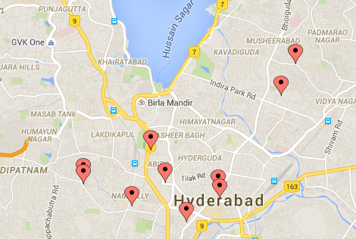
Applications of TATA Communications ATM Data
The ATM level data can be used to fine tune the results obtained by using other aggregated data. It can also be used to create modelled attributes at PIN/Ward level
Application 1 – Granular Location Recommendations
Use ATM location data for further granular and focussed street level planning post identifying a larger geography (PIN/Ward) of potential.
E.g. if PIN 500001 has been identified as a ‘High Potential’ PIN, then we could study the ATM locations for granular recommendation
ATM Location – based on Site Lat Long | Max Transaction Size* | Max Footfall*
Maharani Jhansi Rd, Poosal Basthi, Shankar Bagh Colony | ₹ 2,255 | 649
HIndi Nagar, Ghosha Mahal North, Nampally | ₹ 3,137 | 267
Koti Main Rd, Subhash Nagar, Badi Chowdi | ₹ 5,703 | 79
Sultan Bazar Road | ₹ 2,888 | 502
Mallepally Rd, Mallepally, New Mallepally | ₹ 2,910 | 54
Nampally Station Rd, Old Kattal Mandi | ₹ 3,615 | 297
Mozampura, Bazar Ghat, New Mallepally | ₹ 3,804 | 526
Public Garden Rd, Fateh Maidan | ₹ 4,577 | 517
9th St, Musheerabad, Zamistanpur | ₹ 6,138 | 369
Street Number 7, Musheerabad | ₹ 2,396 | 348
Sapphire Complex, Old Mumbai Hwy, Cyberhills Colony | ₹ 1,816 | 1,063
Granular Recommendations – PIN 500001
Potential Recommendation
* Measured over last 3 months
Application 2 – Model with Aggregated ATM data as Target
Model for Aggregated Location Potential using
Target – ATM data based indicators
Predictors – Aggregated TataIQ data

